Slide 1
ND Mapquest
Patrick Raycroft
“Chas” Jhin
Ashley Taylor
Matt Fitzgerald

Slide 2
Overview
Objective:
To create a program which finds the shortest distance between two points on the ND campus using Dijkstra’s Algorithm
OOP Elements used:
Qt, Nodes, STL templates
Notes:
-Talk both about how the program is structured and how OOP helped make this structure
2

Slide 3
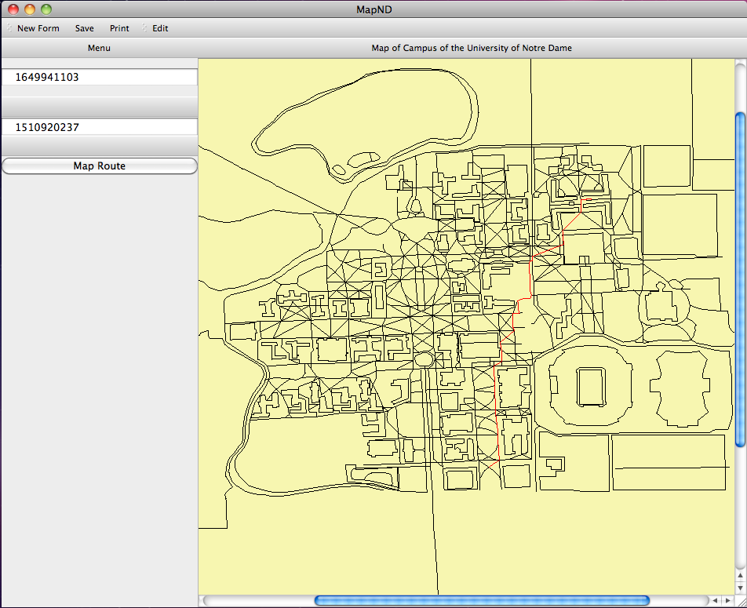

Slide 4

Object Oriented Elements
-Qt graphics
-Widget
-Nodes
-STL templates
-Vectors, Maps
Notes:
-Talk both about how the program is structured and how OOP helped make this structure
4

Slide 5
Why OOP Helped
-Helped organize code
-Easier to conceptualize
-STL
-Modular design of C++
-Different people working on different things

Slide 6
Questions?

